Slide 1
Partial Dependence Plot
Yuanxi Fu
Explainable AI Study Group, UIUC iSchool
Spring23 2nd meeting

Slide 2
What is partial dependence plot
The partial dependence plot (short PDP or PD plot) shows the marginal effect of one or two features have on the predicted outcome of a machine learning model. A partial dependence plot can show whether the relationship between the target and a feature is linear, monotonic or more complex.
Molnar, 2022

Slide 3
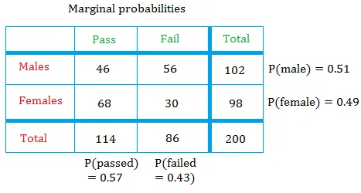
Marginal probability
https://www.basic-mathematics.com/marginal-probability.html

Slide 4
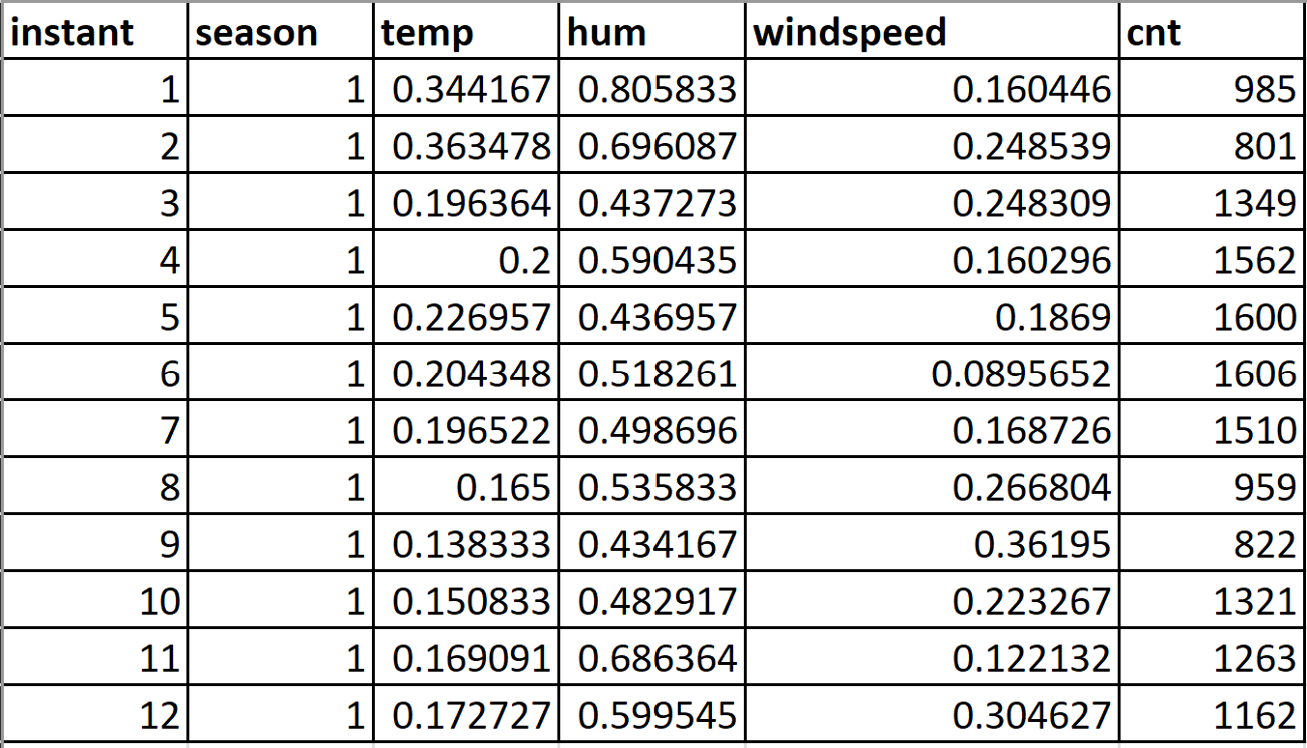
example
Bike rental dataset: Fanaee-T, Hadi, and Gama, Joao, 'Event labeling combining ensemble detectors and background knowledge', Progress in Artificial Intelligence (2013): pp. 1-15, Springer Berlin Heidelberg

Slide 5
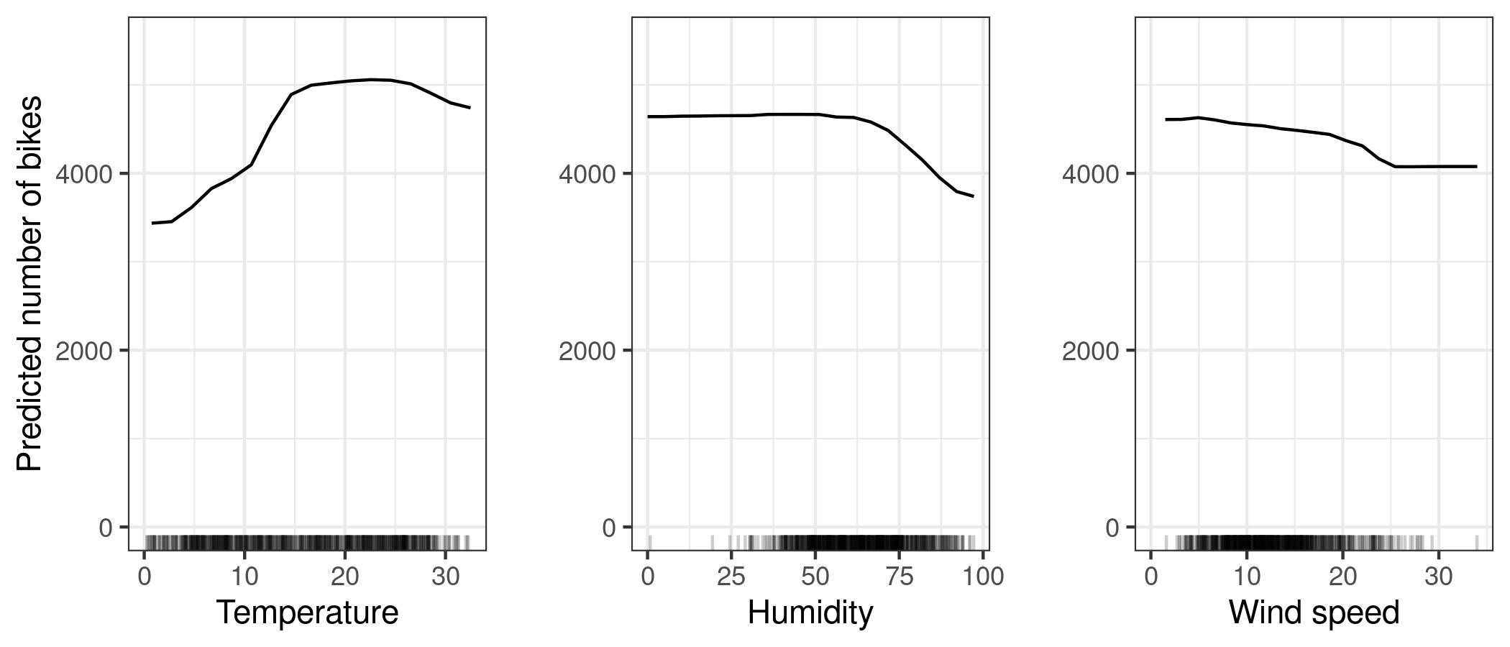
Interpret the plots
Group Discussion: What do you see from the three figures?
Molnar, 2022

Slide 6



The partial dependence function: exact form
Features (one or two) that we want to study (i.e., creating a partial dependency plot)
Other features in the machine learning model, which are treated as random variables.
$$x_{s}$$
$$X_{C}$$
Molnar, 2022

Slide 7
Intuitive interpretation
Partial dependence works by marginalizing the machine learning model output over the distribution of the features in set C, so that the function shows the relationship between the features in set S we are interested in and the predicted outcome.
Molnar, 2022

Slide 8
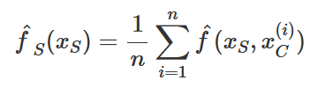


Estimate the partial dependence function
Actual feature values from the dataset for the features in which we are not interested
$$n$$
The number of instances in the dataset
$$x_{C}^{(i)}$$
Molnar, 2022

Slide 9
Estimate the partial dependence function
We force all instances to take a specific value for a particular feature and compute mean prediction.
Actual feature values from the dataset for the features in which we are not interested
$$n$$
The number of instances in the dataset
$$x_{C}^{(i)}$$
Molnar, 2022

Slide 10
Assumption of pdp
An assumption of the PDP is that the features in C are not correlated with the features in S. If this assumption is violated, the averages calculated for the partial dependence plot will include data points that are very unlikely or even impossible.
Molnar, 2022

Slide 11
Feature importance
Intuition: A flat PDP indicates that the feature is not important, and the more the PDP varies, the more important the feature is.
Molnar, 2022

Slide 12
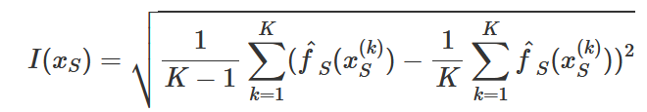

Feature importance
Intuition: A flat PDP indicates that the feature is not important, and the more the PDP varies, the more important the feature is.
Numerical features
Categorical features
Molnar, 2022

Slide 13
Interpret the plots
Group Discussion: Can you say something about feature importance based on these plots?
Molnar, 2022

Slide 14
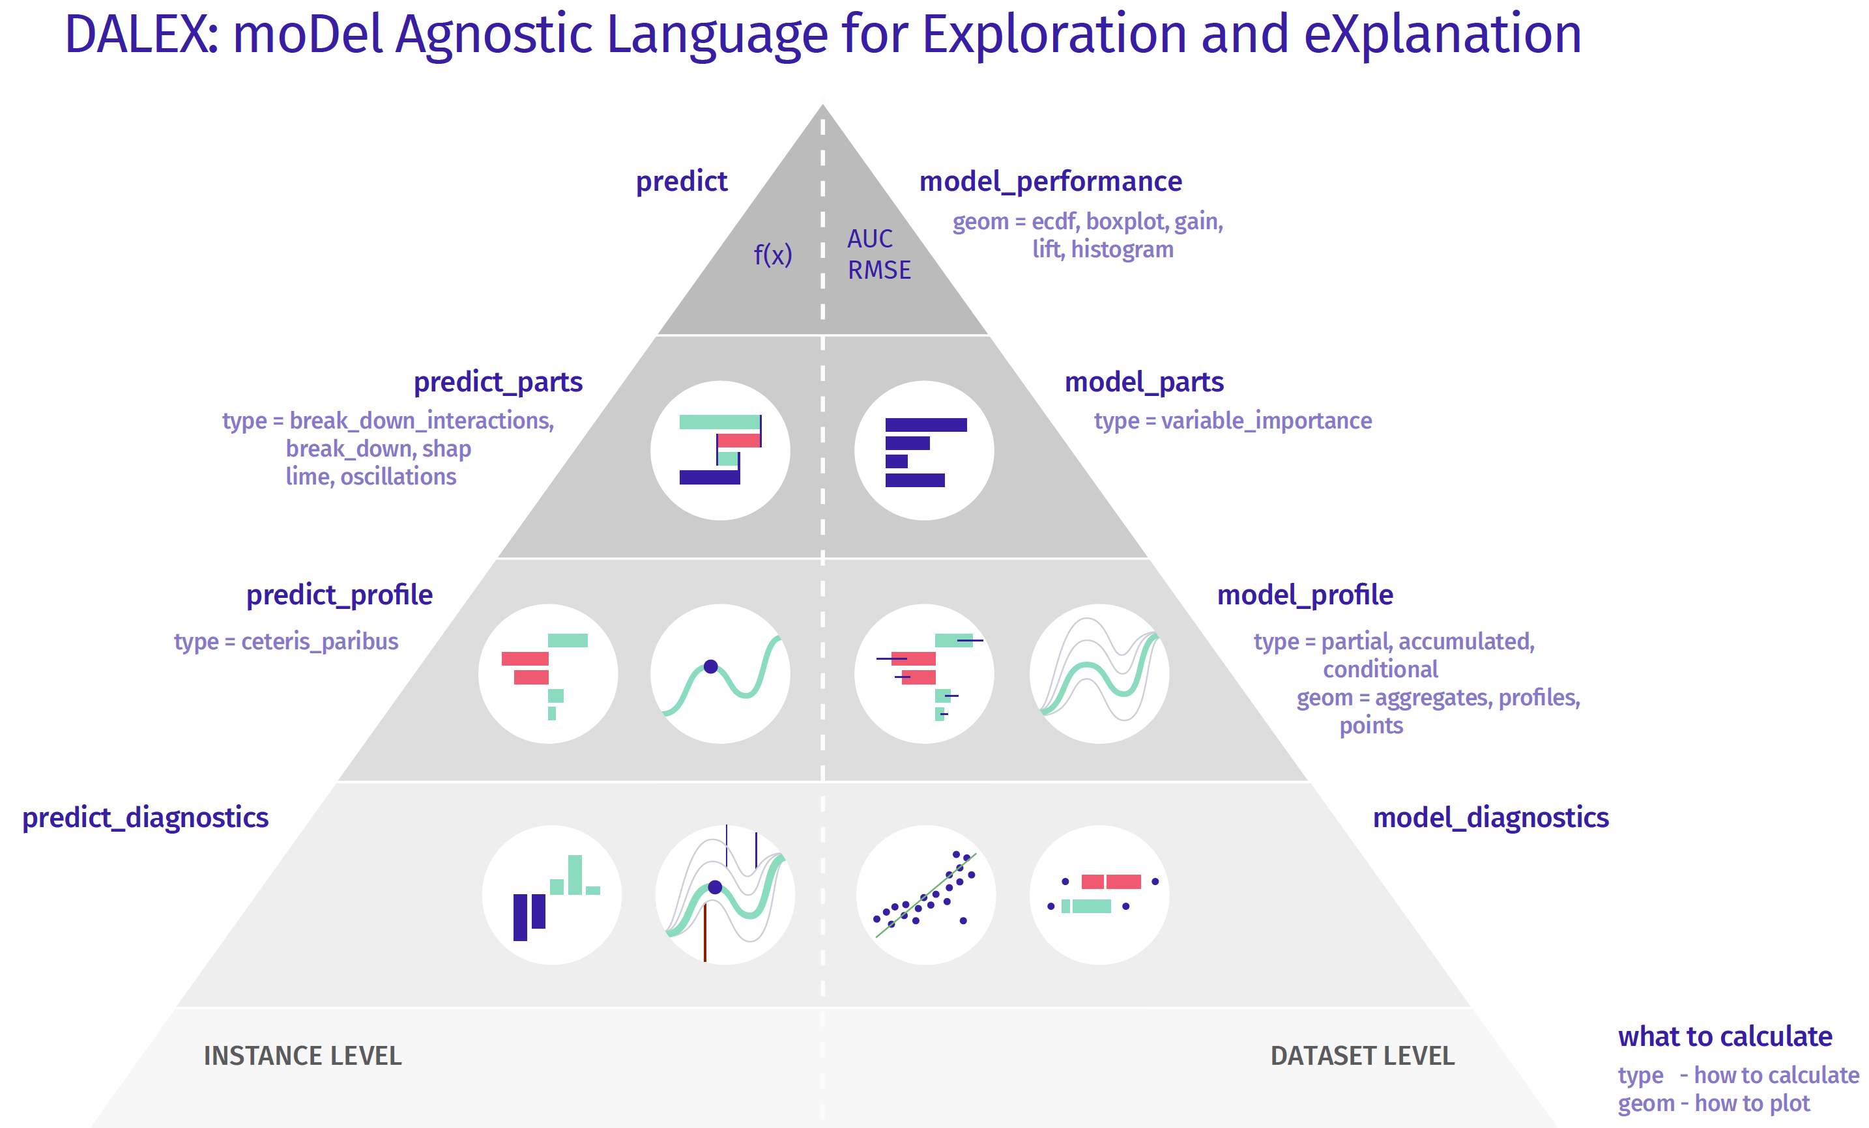
Introduction TO dalex
https://modeloriented.github.io/DALEX/

Slide 15
Sample code in R
https://github.com/yuanxiesa/YF_partial_dependence_plot

Slide 16
Sample code in python
https://github.com/yuanxiesa/YF_partial_dependence_plot

Slide 17
reflections

Slide 18
Advantages
Intuitive and easy to explain to lay people
When the feature(s) you compute are not correlated with other features in your model, the interpretation is clear.
Easy to implement computationally
Molnar, 2022

Slide 19
disadvantages
The realistic maximum number of features in a partial dependence function is two.
The assumption of independence is the biggest issue with PD plots.
Heterogeneous effects might be hidden because PD plots only show the average marginal effects. Suppose that for a feature half your data points have a positive association with the prediction – the larger the feature value the larger the prediction – and the other half has a negative association – the smaller the feature value the larger the prediction.
Can be misleading is we do not plot the sample distributions with the PDPs.
Molnar, 2022

Slide 20
Reference
Molnar, C. (2020). Interpretable Machine Learning. Lulu.com.

